Slide 1
Health Care Data challenge
Created by alec Gilfillan for Holmusk

Slide 2
Observations about raw data
Four datasets with different data structures
Bill_Amount: one row per bill, can have multiple bills for one admission date
Bill_ID: one row per bill amount
Demographics: one row per patient
Clinical_Data: one row per patient per admission date
Key: data structures need to be taken into account before merging all datasets together

Slide 3
Merging
Bill_Amounts and Bill_ID easily merge 1-1 using bill_id as the key
Then, bill amounts can be reduce to one row per admission date by taking the sum of all bills on a given date
Next, demographics and bills easily merge onto the clinical data

Slide 4
Data Cleaning
Several variables needed to be cleaned:
After examining the raw data, any observation with a blank was imputed to 0
Gender contains multiple values that specify male or female. A new variable, Female, was created with a 1 or 0 to specify gender
Resident status, Race, and Medical History all needed changes to prepare for analysis as well

Slide 5
Analysis
Research question: can we predict the cost of a first time admission?

Slide 6
Analysis
Step 1:
Look at very at correlations between variables
Strongest correlation:
Symptom 5 and cost of first-time admission: 0.52, a very strong correlation in the healthcare domain

Slide 7
Analysis
Step 2: consider taking the log of the cost per admission date

Slide 8
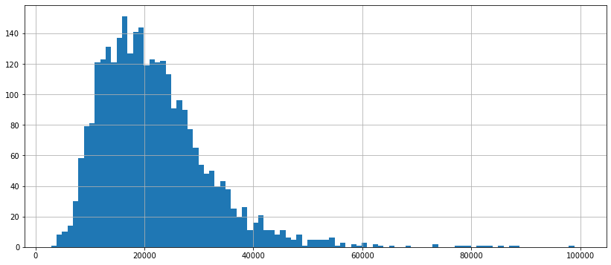
Analysis Histogram of cost per admission date

Slide 9
Analysis
Conclusion: there are a few outliers but the data is distributed normally enough that we don’t need to take the natural log. This will make interpretation of regression results easier.

Slide 10
Analysis
Regression model:
Independent Variables: 'age’, 'female’, 'medical_history_1’ , 'preop_medication_2', 'symptom_1’, 'symptom_2’, 'symptom_3’, 'symptom_4’, 'symptom_5’, 'weight’, 'race_chinese’, 'race_malay’, 'race_indian’, 'resident_singapore’ 'resident_pr’
Dependent variable:
'amount_by_date'

Slide 11

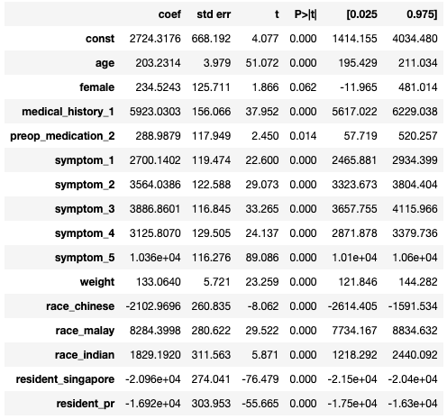
Analysis results
Many statistically significant coefficients
Confirmed that Symptom 5 has as strong effect, on average, on cost per admission date
R-Squared: 0.903, the model explains over 90% of the variation in cost per admission date

Slide 12
Analysis results: Big picture
A first time admittee with symptom 5, on average, costs 10,000 more Singapore dollars holding all other factors constant
Singapore citizens and permanent residents have significantly less costs from their first time admissions than foreign patients
The next largest predictors of cost were having Medical History 1and being Malaysian

